Slide 1
GradRooAte Applications
Joshua Wendl, Alec Sears, Kendal Sutton, David Leatherwood

Slide 2
Faculty Scheduling
Schedule
Faculty scheduling per term
Conditions
No overlapping schedules
Rule based restrictions
Part and full time faculty members
Etc.
Notes:
Class or professor restrictions
Professor or classes can’t be back to back

Slide 3
Accomplishments/ Issues
Successes
Documentations
UI
Database
Problems
COVID-19
Reliable communication
Group member availability

Slide 4



Technologies
C# Language (.NET Core runtime)
Front End
WPF (Windows Presentation Foundation)
ReactiveUI
Real-time search and data display
Logic
.NET Core
Backend/Database Level
SQLite

Slide 5
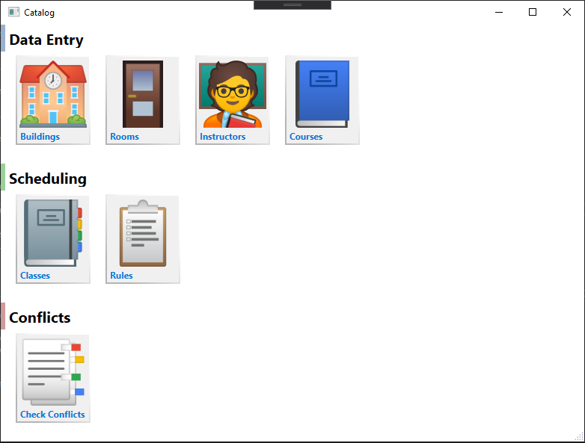
User Interface
Home page lists areas of application
Buttons to navigate to other pages
Data entry page shows list of items
Real-time search
Create, Edit, Delete buttons
Editing window WIP
Scheduling and Conflicts pages WIP
Notes:
*Go to demo after slide*

Slide 6
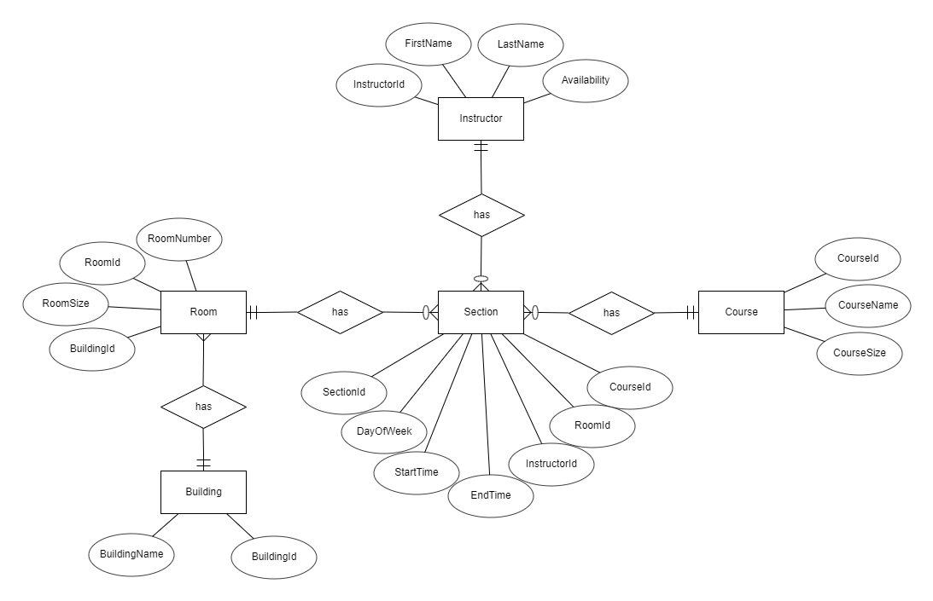
Database
SQLite
Tables for each part of a section
Building
Room
Course
Instructor
Sections hold rules and more
Umbrellas all system data
Implement semester schedules
Check schedule conflicts

Slide 7
Backlog
Schedule improvement suggestion
After schedule check, the system would suggest solutions to the found conflicts
Navigation options
Will allow users to jump from page to page with ease
Login page for multi user usage
Allows users with leveled permissions to perform restricted actions

Slide 8
Conclusion
Senior Project
Learning points
Future endeavors
Improvements
More consistency
Communication
Language/technology repertoire
Time management
Resources
Pandemic impact
Priorities

